Slide 1
Simulation
examples

Slide 2
Example C Flight (in atmosphere)
Deterministic Model

Slide 3
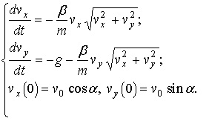
Example C Business model
ρ=1.29

Slide 4
Example C Business model - solution
Runge–Kutta method

Slide 5
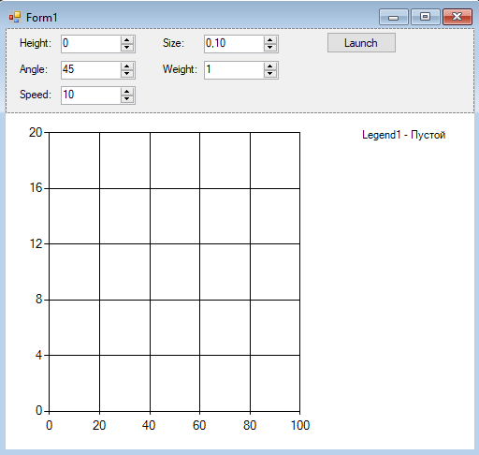
Example C Main window

Slide 6
Example C Formulas
decimal t, x, y, v0, cosa, sina, S, m, k, vx, vy;
private void btLaunch_Click(object sender, EventArgs e)
{
if (!timer1.Enabled)
{
chart1.Series[0].Points.Clear();
t = 0;
x = 0;
y = inputHeight.Value;
v0 = inputSpeed.Value;
double a = (double)inputAngle.Value * Math.PI / 180;
cosa = (decimal)Math.Cos(a);
sina = (decimal)Math.Sin(a);
S = inputSize.Value;
m = inputWeight.Value;
k = 0.5M * C * rho * S / m;
vx = v0 * cosa;
vy = v0 * sina;
chart1.Series[0].Points.AddXY(x, y);
timer1.Start();
}
}
const decimal g = 9.81M;
const decimal C = 0.15M;
const decimal rho = 1.29M;

Slide 7
Example C Timer
const decimal dt = 0.1M;
private void timer1_Tick(object sender, EventArgs e)
{
t += dt;
decimal v = (decimal)Math.Sqrt((double)(vx * vx + vy * vy));
vx = vx - k * vx * v * dt;
vy = vy - (g+ k * vy * v) * dt;
x = x + vx * dt;
y = y + vy * dt;
chart1.Series[0].Points.AddXY(x, y);
if (y <= 0) timer1.Stop();
}

Slide 8
Example C Testing be changing dx values
private void timer1_Tick(object sender, EventArgs e)
{
. . . . .
labDistance.Text = "d=" + x;

Slide 9
Laboratory #3
Assignments:
Add business model classes

Slide 10
Project #A (based on the Lab #3)
versions:
Worms
Airplane

